Slide 1
Farm Boy
Notes:
This presentation supports the Farm Boy session at Acton Scott Historic Working Farm.
The session and this presentation are designed to support KS2 children reading Michael Morpurgo’s Farm Boy (ISBN 978-0-00-675412-1).
After children have read the book, use the pre-visit presentation to prepare for your visit to the farm, and the post-visit presentation to reflect on their experiences.

Slide 2
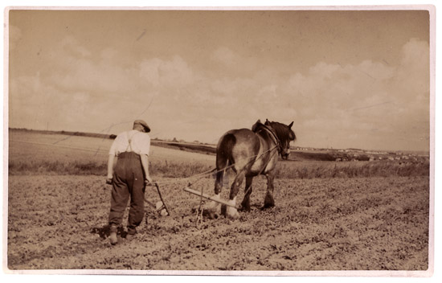
Notes:
Pre – visit presentation
Here is a man ploughing a field with his horse in the 1930s – this is the time when Grandpa’s Story was set.
Ploughing is just one of the jobs a man and a horse would do together around the farm.
What does ploughing involve? The man and horse go back and forth, turning the soil over to make furrows. Fresh soil comes to the surface and any dead plants/weeds get buried underground where they rot down. This prepares the field for the planting of a new crop.
Look at how the man and horse are leaning – it’s hard and heavy work. They would work all day to plough one acre of land. That’s smaller than a football pitch.
Imagine what it was like, working alone all day long with just your horse for company. Imagine Father with Joey and Zoey, and the bond they had.
You will meet working horses and learn ploughing skills when you visit Acton Scott.

Slide 3
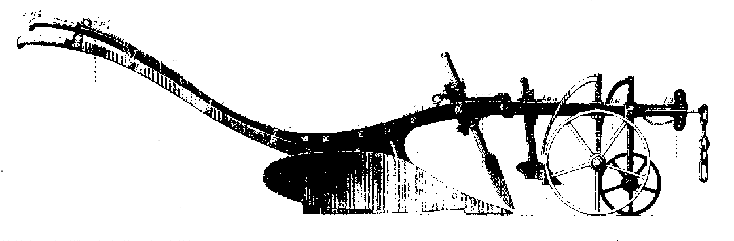
Land Wheel
Knife Coulter
Mould Board
Plough Share
Furrow Wheel
Notes:
This is a diagram of a horse-drawn plough, like the one in the photo. You will see old-fashioned ploughs, like this one, on your visit.
Which part would be connected to the horse’s harness, and where would the man hold on?
The Land Wheel and Furrow Wheel help man and horse guide the plough so that the new furrow is right next to the last one they made.
The Knife Coulter and Plough Share slice through the ground, digging the furrow.
The Mould Board turns over the ground, so that what was on the surface is now underground.
In the story, Father sharpened his plough on Bonfire Night to prepare for the ploughing match. Which parts of the plough need to be sharp?
A horse-drawn plough is very simple, so it is easy to repair and look after. Spare parts could be made by the local blacksmith so it did not cost a lot to maintain.

Slide 4
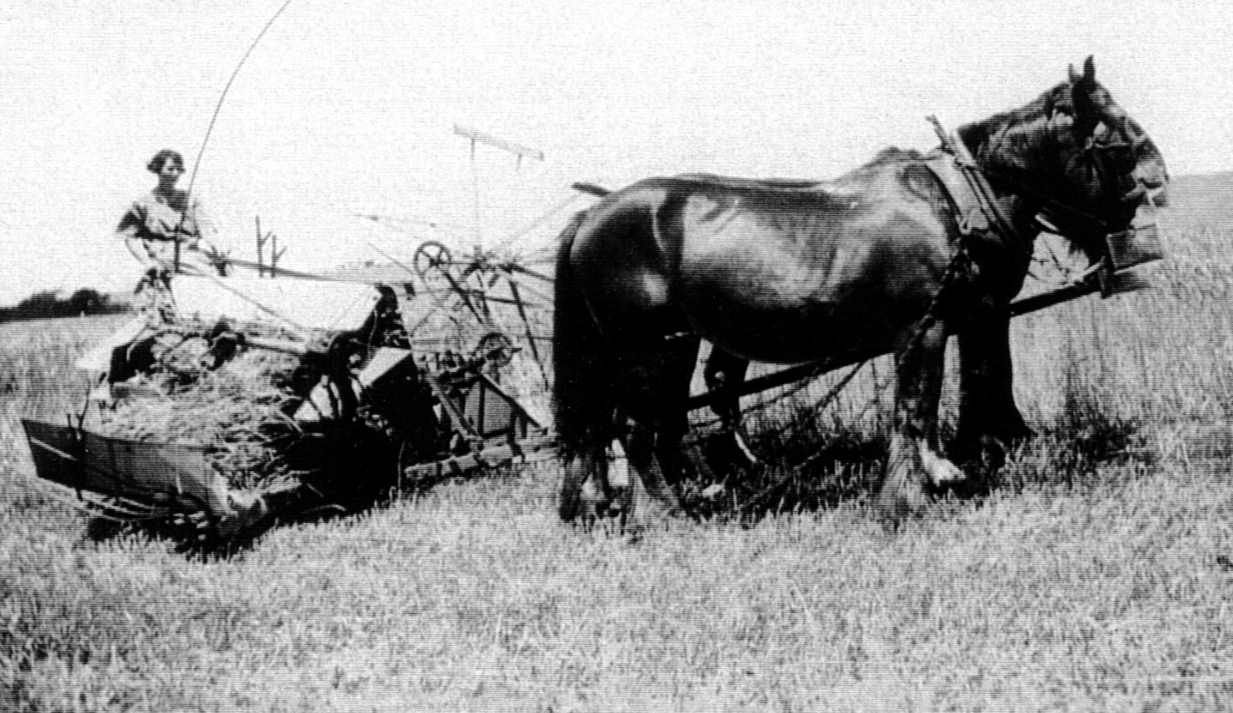
Notes:
In this photo, two horses are working side by side, pulling a reaper-binder. You will see one of these machines at Acton Scott.
A reaper-binder cuts the wheat and ties it into sheaves. This was a really labour-saving machine – it replaced teams of men cutting the wheat with sickles and binding the sheaves by hand. Here, a woman is getting the same task done all on her own.
Machines, particularly tractors, made a big difference to farm life – less physical strength was needed which meant that women could do jobs which only men had been able to do before. During the First World War, women and tractors kept farms going while the men and horses went to war in the trenches.
But, just like Harry Medlicott’s tractor, the reaper-binder was quite likely to break down. Machines promised so much, but sometimes let people down. Early farm machines were still quite simple, so it was easy to work out what had gone wrong and fix it, just like Harry did.
What machines are used for reaping and binding these days? A combine harvester reaps, threshes and winnows the wheat - grain comes down the chute and straw is left in lines in the field. The farmer then tows a baler around the field behind his tractor so that the straw can be packed into bales, ready to store in a barn until they are needed.

Slide 5
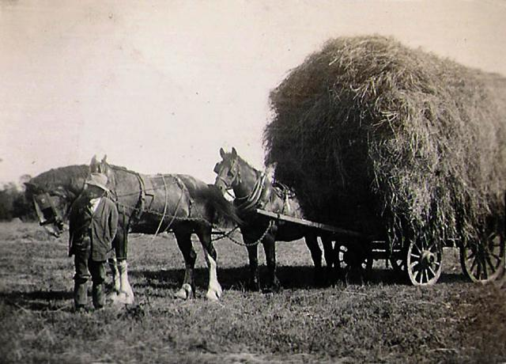
Notes:
In this photo, the horses are harnessed one behind the other, pulling a cart loaded with sheaves.
The harness makes the most of the horses’ strength. When you come to Acton Scott, you will understand just how strong horses are, and how harness works.
Can you see the blinkers? Do you know what they are for? For all their size and strength, horses can be easily frightened or put off their work, blinkers help because the horse can only look forwards, not all around them.
Horses have character; they have good days and bad days - just like us. You’ll see this when you meet Charlie and Joe during your visit. Hopefully, they’ll be having a good day!

Slide 6
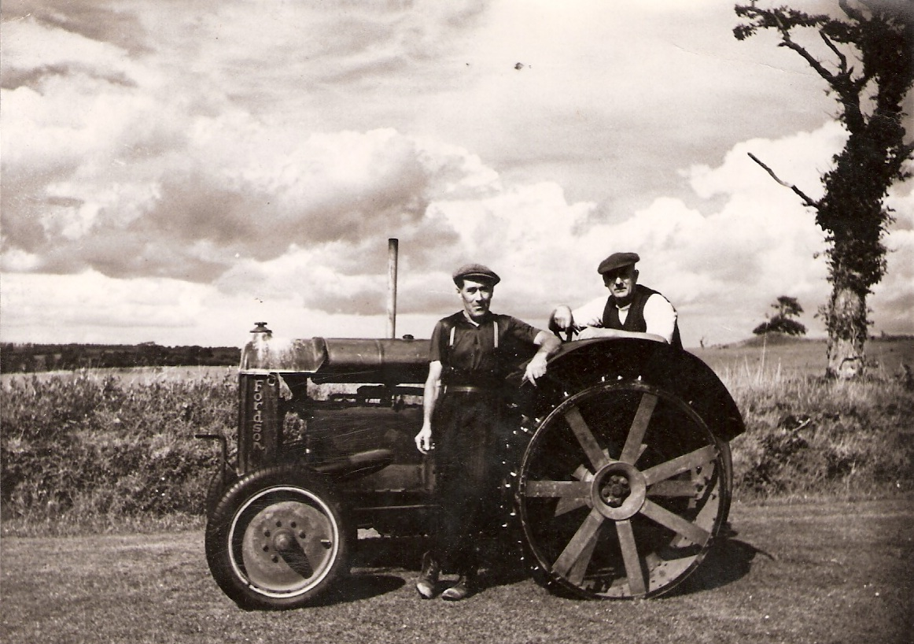
Notes:
This is an early Fordson tractor - like the one Harry Medlicott owned. We have a 1947 Fordson Major at Acton Scott.
What differences can you see compared with a modern tractor? Look at the back wheel, and where is the cab?
When tractors were first introduced, they could plough an acre in half an hour – this could take a day for a man with a horse. Remember how Harry Medlicott showed off?
“My Fordson can plough a field five times as fast as your two old bag of boneses.”
Modern, powerful tractors can plough an acre in five minutes.

Slide 7
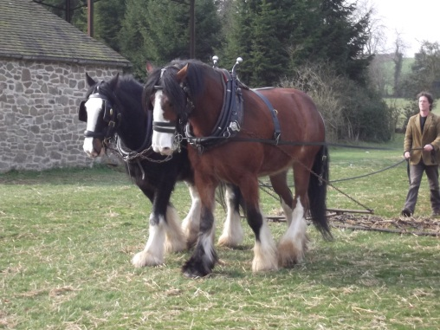
Notes:
Here are two of our working horses, Charlie (left) and Joe (right), at Acton Scott. They are learning how to pull a chain harrow. A field is harrowed after it is ploughed. The harrow breaks up the clods of soil to make it crumbly, ready for seeds to be sown.
Charlie and Joe look forward to meeting you!

Slide 8
Notes:
Post-visit presentation
Now you have a much better idea what it is like to work with horses like Charlie and Joe.
You can listen to an archive recording describing life with heavy horses by following this link:
http://www.discovershropshire.org.uk/html/search/verb/GetRecord/theme:20090105123438
Can you draw up a timetable for a typical waggoner’s day?
You can listen to an archive recording describing what it was like by following this link:
http://www.discovershropshire.org.uk/html/search/verb/GetRecord/theme:20081222102838
There are many other archive recordings of farm workers describing their lives on the Discover Shropshire website, including accounts of horse shoeing, threshing and haymaking.

Slide 9
Collar
Hames
Blinkers
Swingletree
Bridle
Back strap
Notes:
Now you understand what a harness is and how it converts the horse’s strength into pulling power!
You can use this picture to revise the names of parts of the harness.
Can you design your own horse brass to decorate the harness?

Slide 10
Notes:
There are all sorts of old farm machines at Acton Scott. Some were pulled by horses, some were powered by steam engines, and we have our old Fordson tractor, of course.
Steam engines were very powerful, but also extremely heavy – they were useful for static jobs, like threshing, but hopeless for jobs in the fields, like ploughing, because they got bogged down.
Internal combustion engines (like the one you have in a car or tractor) are much lighter and so it was possible to move the power source around. Early tractors had very simple engines, so when they went wrong, farmers could fix it themselves. Remember Harry Medlicott? He fixed his tractor himself.
Nowadays, tractors can be complicated - they do other jobs for the farmer, e.g. help him keep furrows straight with GPS – but this means they are very expensive to buy and repair. Specialist engineers, computers and parts are needed – the days of farmer and blacksmith working it out together are long gone!
Horses, steam engines, old tractors, modern tractors – they all have advantages and disadvantages – we have to weigh them up and decide what is best. Father had to do this in Farm Boy – sometimes change can be very hard to accept.

