Slide 1
What is Shropshire’s SEND Local Offer
and how can it help children, young people and families?
www.shropshire.gov.uk/the-send-local-offer/

Slide 2
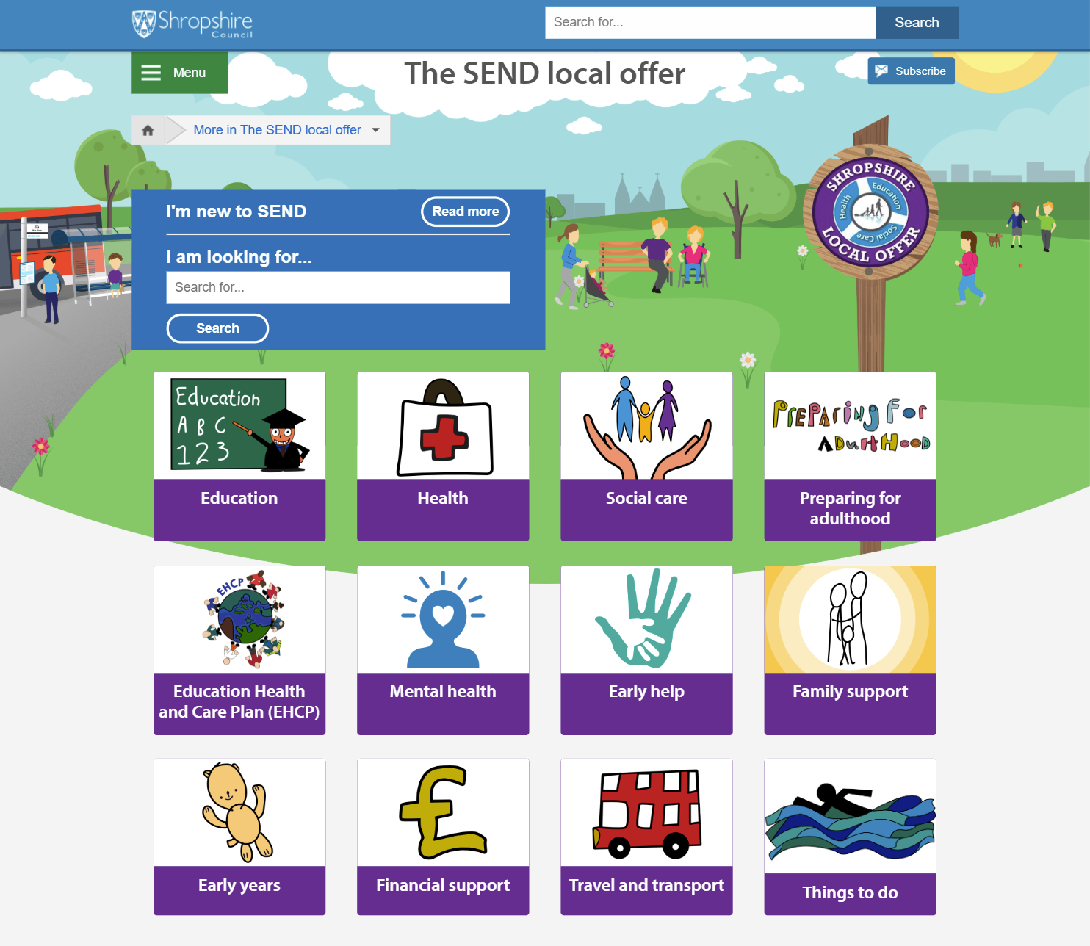
The SEND Local Offer
is a single place for information, services and support for children and young people with special education needs and / or disabilities, their families and the practitioners who support them.
www.shropshire.gov.uk/the-send-local-offer/

Slide 3
Education –
What’s on the Local Offer?
Think your child may have Special educational needs? The Local Offer has information about how the SEN Team and school can support your child.
Nurseries, schools and colleges Local further education options, specialist provision, and a list of schools.
Shropshire's local further education providers Further education colleges and training providers in Shropshire.
Find out about the Education services in Shropshire that can support you and your family.
Details on how to resolve disagreements relating to SEND, including information on mediation and the SENDIST Special Educational Needs and Disability Tribunal.
Find out how to request an EHCP (Education, health and care plan) assessment, get information about the annual review process, and quick reference FAQs.
www.shropshire.gov.uk/the-send-local-offer/

Slide 4
Health –
What’s on the Local Offer?
The Local Offer Health page outlines the health services available to children and young adults with SEND, including those without EHCPs. This includes:
Children’s Continuing Care
Children's Community Physiotherapy
GPs & Dentistry SEND Services
Psychology
Wheelchair and Posture Service
Occupational Therapy services
Young People’s Community Eating Disorders Service
Public Health & Children’s Community Nursing Services
Child Development Centres
Speech and Language Therapy (SALT)
Children’s Hospice Service
Annual Health Checks
Specialist Services
Vaccinations
www.shropshire.gov.uk/the-send-local-offer/

Slide 5
Social Care –
What’s on the Local Offer?
Disabled Children's Team - Helping children and young people with permanent and severe disabilities.
Early help – Find out about the Early help support available to support a child, young person or their family as soon as a problem starts.
Looked-after children - Those receiving care because of a court order or by voluntary agreement with parents.
Find out more about the specialist help available from the Shropshire Virtual School.
Transitioning from children's to adult social care - The steps you need to take for a smooth transition into adult social care.
Personal budgets and direct payments – Find out how a personal budget can allow you to buy and manage services yourself.
Occupational Therapy (OT) Team - Find out about the support available via Occupational Therapist assessments, advice, and support in the home through the provision of equipment and/or adaptations to ensure safety, maximise mobility and promote independence.
Short Breaks - Opportunities for disabled children and young people to spend time away from primary carers.
www.shropshire.gov.uk/the-send-local-offer/

Slide 6
Preparing for Adulthood
What’s on the Local Offer?
Education - Want to continue your education after school? Find out about the options available to young people with SEND to continue their education after school and beyond.
Young people preparing to make their own decisions - The rights of young people aged 16 plus to make decisions for themselves.
Housing and independent living - Find out about your housing options and supported living.
Careers and Employment - Lots of helpful advice and guidance available for young people with SEND, to help them to make the step into the world of employment.
Personal stories - Find out about the huge range of experiences of young people with SEND in Shropshire as they become adults.
Social Care - Information about the process of transitioning into adult social care.
Financial support - Find out more about different financial support available to eligible young people.
www.shropshire.gov.uk/the-send-local-offer/

Slide 7
EHCPs (Education, Health & Care Plans)
What’s on the Local Offer?
EHCP FAQs - All the answers to frequently asked questions about EHCPs on one page.
What is an EHCP? Find out what an EHCP is and who is eligible to request one.
Personal Budgets - What is a personal budget and who can request one?
How to request an assessment for an EHCP - Find out how to apply for an EHCP from Shropshire Council.
Resolving disagreements - How we resolve disagreements relating to SEND, including information on mediation and SENDIST (Special Educational Needs and Disability Tribunal).
Annual reviews - What is an EHCP Annual Review, who will be the chair, who will be invited and what will happen at the meeting?
www.shropshire.gov.uk/the-send-local-offer/

Slide 8
Mental Health -
What’s on the Local Offer?
Diagnosis pathways – who can make a diagnosis and how to get a referral to a specialist mental health practitioner (SPMHP).
Early help and support - What to do if you're concerned that a child or young person is showing signs of emotional or mental ill health.
Treatment pathways - such as psychological therapies, family therapy, counselling, group work and pharmaceutical support.
BEAM - Find out more about what BEAM is, who can access it and where to find the drop in sessions in Shropshire.
Crisis Care Management – What is a crisis, when might one occur and how needs will be assessed on a case-by-case basis.
www.shropshire.gov.uk/the-send-local-offer/

Slide 9
Early Help
What’s on the Local Offer?
What is Early Help - Find out more about what Early Help is, how you can access support and how it can prevent issues from getting worse.
Public Health Nursing Service - What does this service offer and how you can access it.
Stages of Early Help Provision - Find out about the various stages of Early Help provision.
The Parenting Team - What this team is responsible for and how you can use their services.
Early Help Family Support Workers - What is the role of the family support worker and how you can get help from one.
Shropshire Young Carers Service - Support available in Shropshire for young carers aged 5 to 18.
Shropshire Domestic Abuse Service - Information on this specialist service and the support packages they offer.
Schools - How schools in Shropshire fulfil their SEND commitments.
www.shropshire.gov.uk/the-send-local-offer/

Slide 10
Family Support –
What’s on the Local Offer?
Information, Advice and Support Service (IASS) - Find out more information about IASS, what they offer and how you can contact them.
Support to keep my child safe online - Some useful links to resources that promote online safety.
Shropshire Parent and Carer Council (PACC) - Information about PACC and how to contact them.
Financial support - Find out more about different financial support available to eligible young people
Citizens Advice - An introduction to the Citizen’s Advice Service and the assistance it offers families.
SEND Support Groups - Local parent carer run support groups to chat and share experiences.
Autism West Midlands (AWM) - Find out more about different financial support available to eligible young people
Family Information Directory - Find out lots of services / organisations that offer support.
www.shropshire.gov.uk/the-send-local-offer/

Slide 11
Early Years –
What’s on the Local Offer?
Early Years Provision – Early years provision in Shropshire is provided by both maintained nurseries and private, voluntary and independent early years provision including childminders.
The Graduated Approach – What are the four stages of this process and what a setting should do at each stage.
SEN Support for 0 – 6 year olds – Links to the support available.
Funded Nursery Entitlement – All children are entitled to 15 hours free nursery education from the term after their third birthday. Find out more about the eligibility criteria for two year olds.
Preferred Providers – Discover what a preferred provider is and how you can request a copy of the list.
Concerned about your child’s development - Find out more about who to talk to and what you can do to check developmental milestones.
Extended childcare – More information about the entitlement for 30 hours free childcare.
www.shropshire.gov.uk/the-send-local-offer/

Slide 12
Financial support –
What’s on the Local Offer?
Benefits
Personal Budgets
Disability Living Allowance (DLA)
SEN Transport Support
Personal Independence Payments (PIP)
Carer’s Allowance
Family Fund
Access to Work Fund
www.shropshire.gov.uk/the-send-local-offer/

Slide 13
Travel and Transport –
What’s on the Local Offer?
Nursery under 5s – Travel assistance available for children under 5 who have an EHCP or SEN.
Apply – Information about how to apply for transport assistance for children with an EHCP or SEN.
Support for 5-16 year olds – Support available for children aged 5-16 with an EHCP or SEN.
Appeals – Information about how to appeal for transport assistance for children with an EHCP or SEN.
Post 16 (16-19 year olds) - Find out more about travel assistance available to students aged 16-19 with an EHCP or SEN.
Top Tips – Tips and helpful things for parent carers to know when applying for transport.
Safeguarding - Explains the duty of care to protect children and vulnerable adults and information on what to do if you think anyone is being harmed or is at risk.
Post 19 (19 year olds+) - Find out more about travel assistance available to students aged 19-25 with an EHCP or SEN.
www.shropshire.gov.uk/the-send-local-offer/

Slide 14
Things to do –
What’s on the Local Offer?
Shropshire Family Information Service – The SEND Local Offer section on the Directory has the following categories:
Young people, leisure, activities, support groups etc.
You will find lots of activities, clubs and fun things to do including:
All In Short Breaks
Youth clubs / groups
SEND Support Groups
Sports / Physical activity sessions
SEND Coffee Mornings
Sing and Sign
SEND Disability Drop In Sessions
SEND swimming clubs
Kids and Holiday Clubs
Dance and movement classes
www.shropshire.gov.uk/the-send-local-offer/

Slide 15
Coronavirus –
What’s on the Local Offer?
Guidance and documents - Find useful guidance and documents from the DfE / NHS relating to coronavirus.
Easy-read materials - A collection of easy read materials to use when talking to children and young people relating to coronavirus including:
Resources and support - A range of useful resources to offer support during the coronavirus pandemic
Explaining coronavirus
Information on the vaccine
Mental health support
Physical health and mobility
Support for parent carer and families
Bereavement support
Educating pupils at home - During potential lockdown periods or episodes of shielding you can find a list of useful resources to use whilst home educating.
Newsletter – Aims to give useful updates and information to help support parent carers of children and young people with special educational needs and disabilities.
www.shropshire.gov.uk/the-send-local-offer/

Slide 16
Find out how Shropshire’s SEND Local Offer can help you at:
www.shropshire.gov.uk/the-send-local-offer/
local.offer@shropshire.gov.uk
0345 678 9063
www.shropshire.gov.uk/the-send-local-offer/

